Slide 1
CHAPTER
14 Monopoly

Slide 2
Barriers to Entry
Monopoly
  A single supplier to a market
  May choose to produce at any point on the market demand curve
Barriers to entry
  The source of all monopoly power
    Technical barriers
    Legal barriers

Slide 3
Technical Barriers to Entry
Production may exhibit decreasing marginal and average costs over a wide range of output levels
  Relatively large-scale firms are low-cost producers
    Firms may find it profitable to drive others out of the industry by cutting prices
    Natural monopoly
    Once the monopoly is established, entry of new firms will be difficult

Slide 4
Technical Barriers to Entry
Special knowledge of a low-cost productive technique
  It may be difficult to keep this knowledge out of the hands of other firms
Ownership of unique resources
  Lasting basis for maintaining a monopoly

Slide 5
Legal Barriers to Entry
Many pure monopolies are created as a matter of law
  Patents - the basic technology for a product is assigned to one firm
  The government may award a firm an exclusive franchise to serve a market

Slide 6
Creation of Barriers to Entry
Some barriers to entry result from actions taken by the firm
  Research and development of new products or technologies
  Purchase of unique resources
  Lobbying efforts to gain monopoly power
  May involve real resource costs

Slide 7
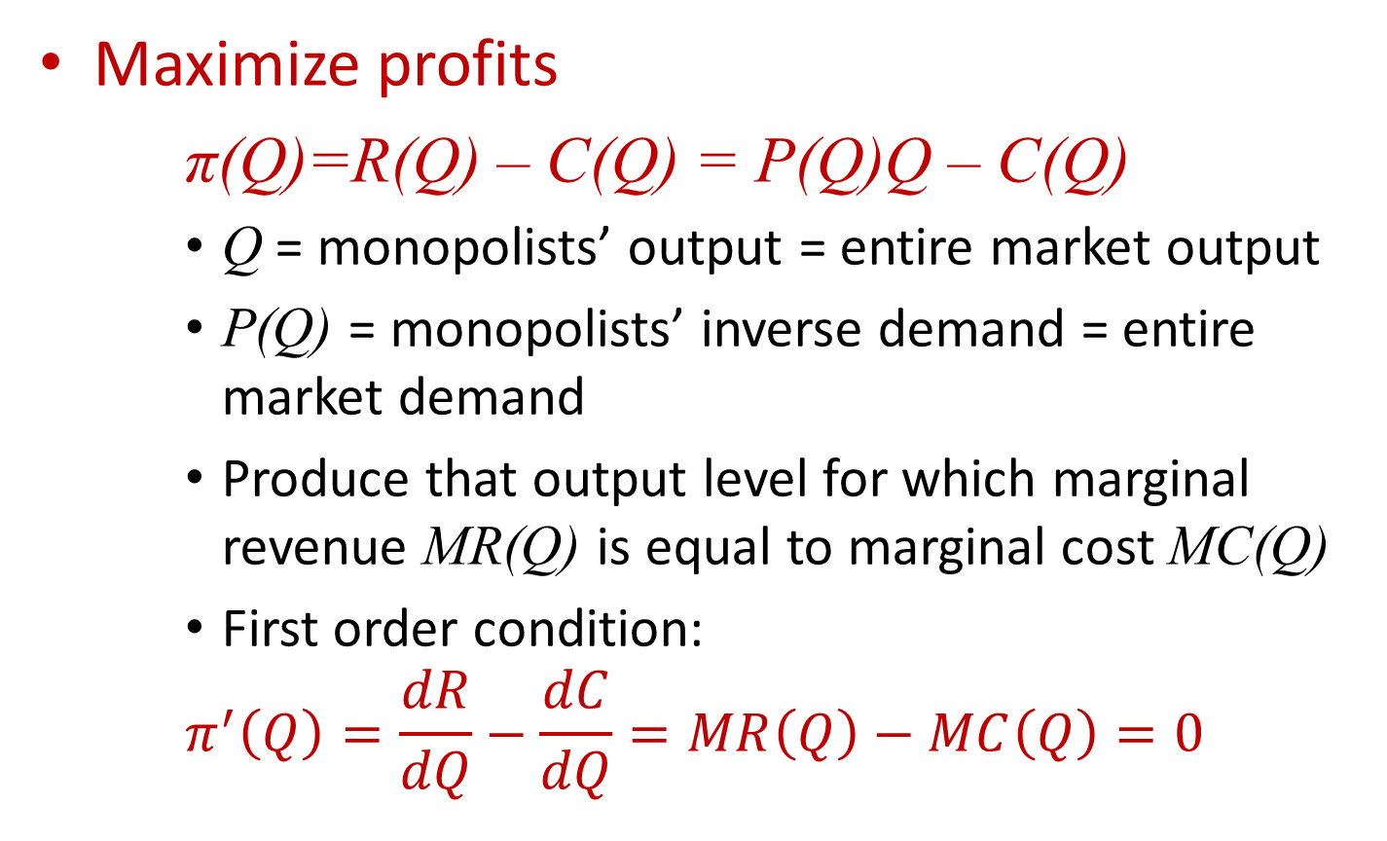
Profit Maximization
Maximize profits
π(Q)=R(Q) – C(Q) = P(Q)Q – C(Q)
    Q = monopolists’ output = entire market output
    P(Q) = monopolists’ inverse demand = entire market demand
    Produce that output level for which marginal revenue MR(Q) is equal to marginal cost MC(Q)
    First order condition:
    $$π^{′}\left(Q\right)=\frac{dR}{dQ}−\frac{dC}{dQ}=MR\left(Q\right)−MC\left(Q\right)=0$$

Slide 8
Profit Maximization
The monopoly
  Faces a negatively sloped market demand curve: P’(Q) < 0
  Marginal revenue < market price:
  MR(Q) = P(Q)+QP’(Q) < P(Q)
  To sell an additional unit, the monopoly must lower its price on all units

Slide 9
14.1 Profit Maximization and Price Determination for a Monopoly
Price
MC(Q)
P_{m}
A
AC(Q)
B
AC_{m}
MR(Q)
P(Q)
Quantity, Q
Q_{m}
A profit-maximizing monopolist produces that quantity for which marginal revenue is equal to marginal cost. In the diagram this quantity is given by Q_{m}, which will yield a price of _{Pm} in the market. Monopoly profits can be read as the rectangle of P_{m}ABAC_{m}.

Slide 10
Profit Maximization
Optimization principle
  A monopolist will choose to produce that output for which MR(Q) = MC(Q)
  Because the monopolist faces a downward-sloping demand curve
    P > MR(Q) and P > MC(Q)

Slide 11
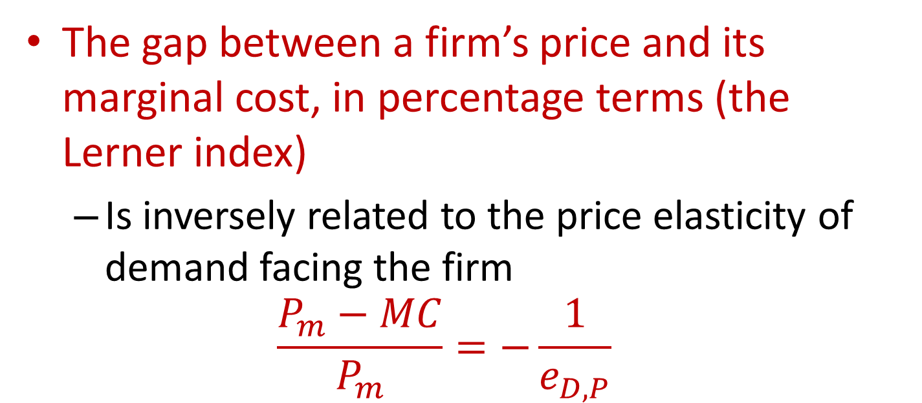
The Inverse Elasticity Rule
The gap between a firm’s price and its marginal cost, in percentage terms (the Lerner index)
  Is inversely related to the price elasticity of demand facing the firm
  $$\frac{P_{m}−MC}{P_{m}}=−\frac{1}{e_{D,P}}$$
  Where e_{D,P} is the elasticity of demand for the entire market

Slide 12
The Inverse Elasticity Rule
General conclusions about monopoly pricing
  A monopoly will choose to operate only in regions where the market demand curve is elastic, e_{D,P} < -1
  The firm’s “markup” over marginal cost depends inversely on the elasticity of market demand

Slide 13
Monopoly Profits
Monopoly profits
  Will be positive as long as P_{m} > AC_{m}
  Can continue into the long run because entry is not possible
    Monopoly rents - the return to the factor that forms the basis of the monopoly
  The size of monopoly profits in the long run
    Depend on the relationship between average costs and market demand for the product

Slide 14
14.2 Monopoly Profits Depend on the Relationship between the Demand and Average Cost Curves
Price
Price
MC
MC
AC
AC
P_{m}
P_{m}=AC_{m}
AC_{m}
D
D
MR
MR
Q_{m}
Quantity
Q_{m}
Quantity
(a) Monopoly with large profits
(b) Zero-profit monopoly
Both monopolies in this figure are equally ‘‘strong’’ if by this we mean they produce similar divergences between market price and marginal cost. However, because of the location of the demand and average cost curves, it turns out that the monopoly in (a) earns high profits, whereas that in (b) earns no profits. Consequently, the size of profits is not a measure of the strength of a monopoly.

Slide 15
There is No Monopoly Supply Curve
With a fixed market demand curve
  The supply “curve” for a monopolist will only be one point
    The price-output combination where MR = MC
If demand shifts
  The marginal revenue curve shifts
  And a new profit-maximizing output will be chosen

Slide 16
14.1 Calculating Monopoly Output
Market for Frisbees
  Linear demand curve:
Q = 2,000 - 20P or P = 100 - Q/20
  The total costs of a monopoly Frisbee producer:
C(Q) = 0.05Q² + 10,000
  Maximize profits - choose the output for which MR = MC
  Total revenue: TR = P⋅Q = 100Q - Q²/20
  Marginal revenue: MR = 100 - Q/10
  Marginal cost: MC = 0.1Q

Slide 17
14.1 Calculating Monopoly Output
MR = MC
  Q_{m} = 500
  P_{m} = 75
  C(Q) = 22,500
  AC_{m} = 45
  π_{m} = (P_{m} – AC_{m})Q_{m} = 15,000

Slide 18
14.2 Monopoly with Simple Demand Curves
The inverse demand function facing the monopoly is linear: P = a – bQ
    Revenue is PQ = aQ – bQ²
    MR = a – 2bQ
  Profit maximization: MR = MC
    MR = a – 2bQ = MC = c
  Q_{m} = (a – c)/2b
  P_{m} = a – bQ_{m} = a – (a – c)/2 = (a + c)/2

Slide 19
14.2 Monopoly with Simple Demand Curves
Constant elasticity demand function, Q = aP^{e}
MR = P(1 + 1/e)
  Profit maximization
MR = P(1 + 1/e) = c
P_{m} = c(e/(1 + e)
  Because e < -1 for profit maximization, P > MC
    The gap will be larger the closer e is to -1

Slide 20
Misallocated Resources Under Monopoly
Allocational effect of a monopoly
  Perfectly competitive, constant-cost industry as a basis of comparison
    The industry’s long-run supply curve is infinitely elastic
      Price equal to both marginal and average cost

Slide 21
14.3 Allocational and Distributional Effects of
Monopoly
Price
Transfer from
consumers to firm
A
Monopolization of this previously competitive market would cause output to be reduced from Q_{c} to Q_{m}. Productive inputs worth FEQ_{c}Q_{m} are reallocated to the production of other goods. Consumer surplus equal to P_{m}BCP_{c} is transferred into monopoly profits. Deadweight loss is given by BEF.
MC(Q)
B
P_{m}
Deadweight loss
E
P_{c}
C
F
G
P(Q)
MR(Q)
Value of
transferred inputs
Q_{m}
Q_{c}
Quantity

Slide 22
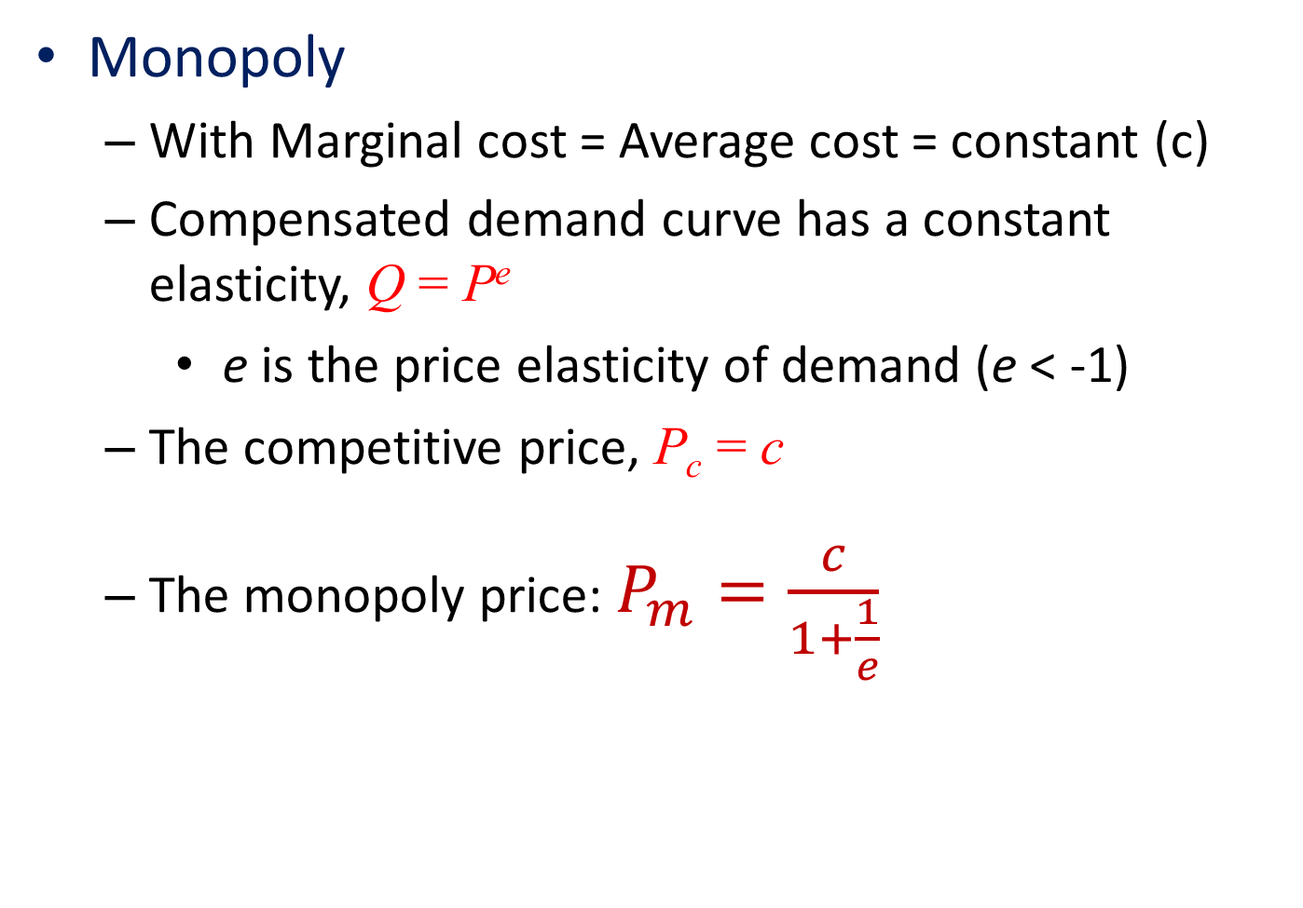
14.3 Welfare Losses and Elasticity
Monopoly
  With Marginal cost = Average cost = constant (c)
  Compensated demand curve has a constant elasticity, Q = P^{e}
    e is the price elasticity of demand (e < -1)
  The competitive price, P_{c} = c
  The monopoly price: $P_{m}=\frac{c}{1+\frac{1}{e}}$

Slide 23
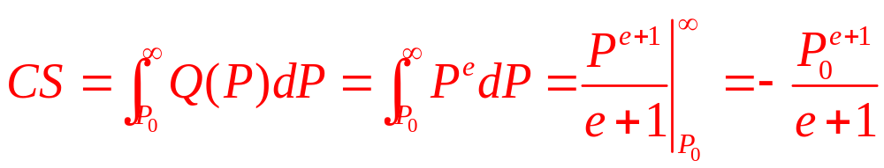
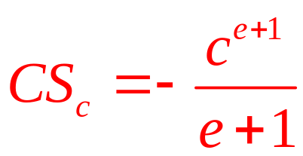
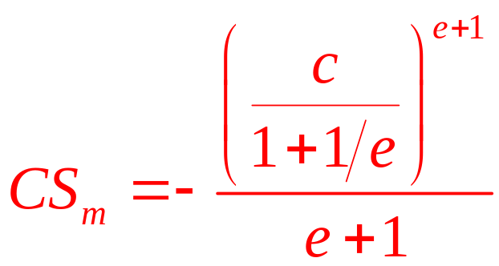
14.3 Welfare Losses and Elasticity
Consumer surplus associated with a price (P₀)
  Under perfect competition:
  Under monopoly:

Slide 24
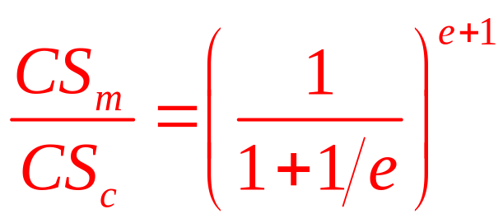
14.3 Welfare Losses and Elasticity
Consumer surplus ratio
  If e = -2, this ratio is ½
    Consumer surplus under monopoly is half what it is under perfect competition

Slide 25
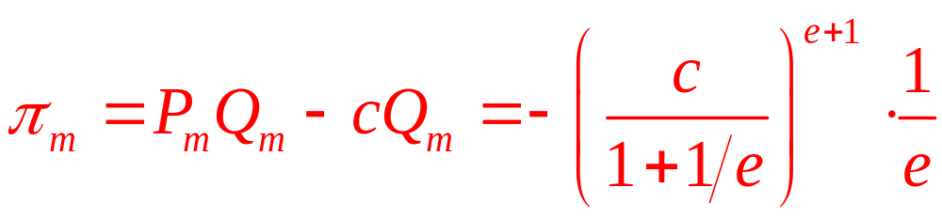
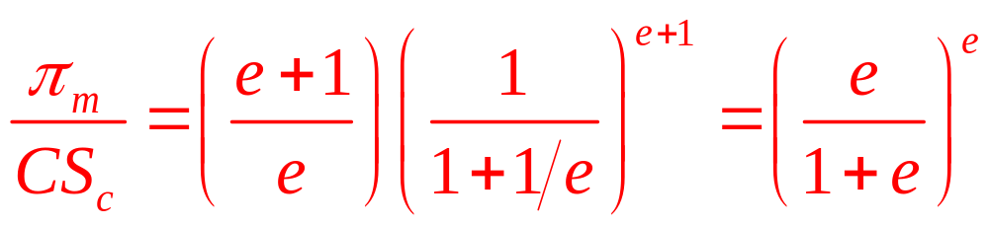
14.3 Welfare Losses and Elasticity
Monopoly profits
Transfer from consumer surplus into monopoly profits:
  If e = -2, this ratio is ¼

Slide 26
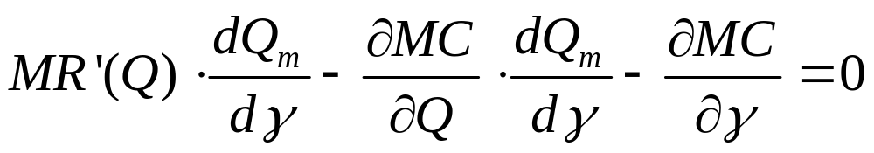
Comparative Statics Analysis Of Monopoly
Prove that a monopolist reduces its output in response to an upward shift in its MC curve
  Marginal cost: MC(Q,γ)
    Where γ is some factor shifting the curve up: ∂MC/∂γ>0
  First-order condition: MR(Q) – MC(Q,γ)=0
  Total differentiating:

Slide 27
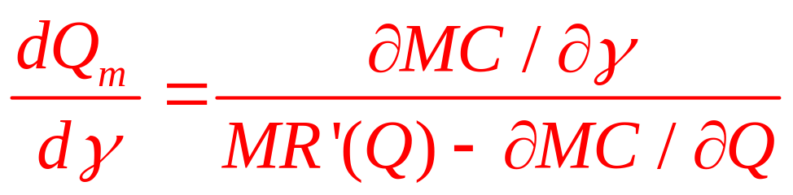
Comparative Statics Analysis Of Monopoly
  Solving:
  An increase in the marginal cost shifter reduces monopoly output: dQ_{m}/dγ < 0

Slide 28
Monopoly Product Quality
Market power
  May be exercised along dimensions other than the market price
  Type, quality, or diversity of goods
Higher-quality or lower-quality than competitive firms?
  Depends on demand and the firm’s costs

Slide 29
Monopoly Product Quality
Consumers’ willingness to pay for a good of quality X
  Given by the inverse demand function P(Q,X) where ∂P/∂Q = P_{Q} < 0 and ∂P/∂X = P_{X} > 0
Costs of producing Q and X is given by C(Q,X)
  With ∂C/∂Q = C_{Q} > 0 and ∂C/∂X = C_{X} > 0
Maximize: π = P(Q,X)Q - C(Q,X)
  Finding optimal output Q_{m} and quality X_{m}

Slide 30
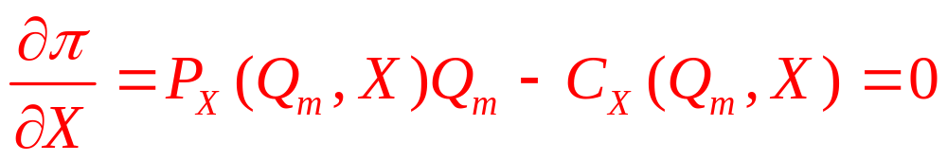
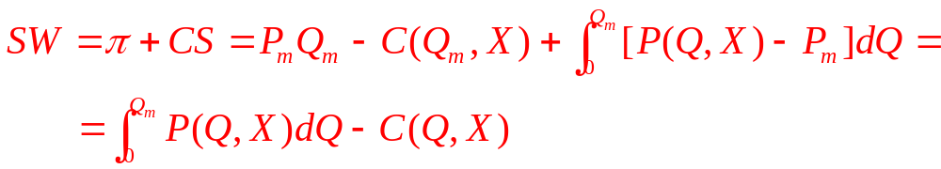
Monopoly Product Quality
First-order condition:
Level of product quality chosen under competitive conditions
  Is the one that maximizes net social welfare

Slide 31
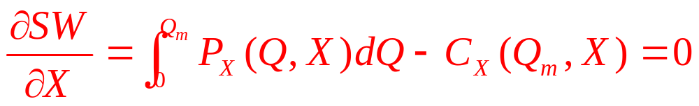
Monopoly Product Quality
Differentiation with respect to X
  Yields the first-order condition for a maximum

Slide 32
Monopoly Product Quality
Quality choice, monopolist
  Marginal consumer’s valuation of quality
    Increasing the attractiveness of the product to the marginal consumer: increases sales
Quality choice, social planner
  Maximizes consumer surplus across all buyers
    Equivalent to maximizing the average consumer surplus across buyers

Slide 33
Product Durability
Durable goods
  Goods that provide services to their owners over several periods
Swan’s independence assumption
  Demand for durable goods - demand for a flow of services over several periods
    Minimize the cost of providing this flow to consumers
  Output decisions - treated independently from decisions about product durability

Slide 34
Price Discrimination
Price discrimination
  Sell otherwise identical units of output at different prices
    Whether it is feasible depends on the inability of buyers to practice arbitrage
Perfect price discrimination
  Charge each buyer the maximum price he would be willing to pay for the good
    Extracts all consumer surplus
    No deadweight loss

Slide 35
14.4 Perfect Price Discrimination
Price
A
P₁
Under perfect price discrimination, the monopoly charges a different price to each buyer. It sells Q₁ units at P₁, Q₂ - Q₁ units at P₂, and so forth. In this case the firm will produce Q*, and total revenues will be AEQ*0.
P₂
E
MC
P(Q)
Quantity
Q₁
Q₂
Q*

Slide 36
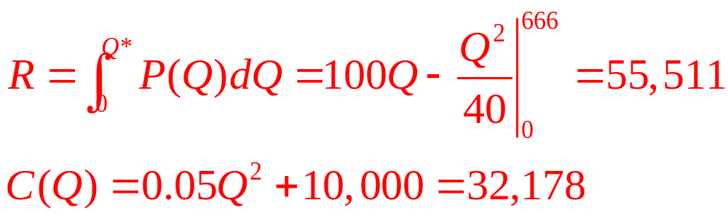
14.4 Perfect Price Discrimination
Frisbee manufacturer
Perfect price discrimination
  The firm will want to produce the quantity at which price is exactly equal to marginal cost
  P = 100 - Q/20 = MC = 0.1Q, so Q* = 666
  Total revenue and total costs will be
  Profit is much larger (23,333 > 15,000)

Slide 37
Segmented Markets
Perfect price discrimination
  Requires the monopolist to know the demand function for each potential buyer
Price discrimination across segmented markets
  Monopoly can sement its buyers into a few identifiable markets
  Can follow a different pricing policy in each market

Slide 38
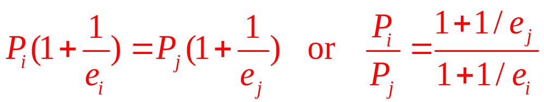
Segmented Markets
Price discrimination, segmented markets
  Knowing the price elasticities of demand in these markets
  Set a price in each market according to the inverse elasticity rule
    Assuming that marginal cost is the same in all markets
  The profit-maximizing price will be higher in markets where demand is less elastic

Slide 39
Segmented Markets
Ambiguous welfare consequences
  If total amount sold in the two markets under price discrimination = quantity sold under a single price
    Higher welfare under single price
  Price discrimination can in some cases increase total output sold across the markets
    Higher welfare under price discrimination

Slide 40
14.5 Price Discrimination across Segmented
Markets
Price
P*₁
P*₂
MC
MC
P₂(Q₂)
P₁(Q₁)
MR₁(Q₁)
MR₂(Q₂)
Quantity in Market 1
Q₁*
0
Q₂*
Quantity in Market 2
If two markets are separate, then a monopolist can maximize profits by selling its product at different prices in the two markets. This would entail choosing that output for which MC=MR in each of the markets. The diagram shows that the market with a less elastic demand curve will be charged the higher price by the price discriminator.

Slide 41
14.5 Price Discrimination across Segmented
Markets
Inverse demand curves in two separated markets: P₁ = 24 – Q₁ and P₂ = 12 – 0.5Q₂
  For MC = 6
  Profit maximization:
MR₁ = 24 – 2Q₁ = 6 = MR₂ = 12 – Q₂
  Optimal choices and prices are
Q₁* = 9, P₁* = 15 and Q₂* = 6, P₂* = 9
  Profits for the monopoly are
π = (P₁ - 6)Q₁ + (P₂ - 6)Q₂ = 81 + 18 = 99

Slide 42
14.6 Scale Drawing of the Two Widget Markets
In Numerical Example
Price
24
•
15
12
•
DW₁
9
MC
DW₂
6
P₁(Q₁)
MR₁(Q₁)
MR₂(Q₂)
P₂(Q₂)
18
9
0
6
12
Quantity
in market 1
Quantity
in market 2
This figure provides a graphical representation of third-degree price discrimination as in Figure 14.5 but for the special case of the widget markets in the present numerical example. Provides the numbers needed to compute shaded deadweight-loss triangles.

Slide 43
14.5 Price Discrimination across Segmented
Markets
Calculate the deadweight losses, competitive output
DW = DW₁ + DW₂ =
= 0.5(15-6)(18-9) + 0.5(9-6)(12-6) = 40.5+9
If this monopoly were constrained to charge a single price
  Set P = 15 and sell only in the first market
Deadweight loss increases
  DW = DW₁ + DW₂ = 40.5 + 0.5(12 – 6)(12 – 0)
  DW = 40.5 + 36 = 76.5

Slide 44
Price Discrimination Through Non-Uniform Schedules
Monopoly
  Choose a price schedule that provides incentives for demanders to separate themselves
    Depending on how much they wish to buy
  Quantity discounts, minimum purchase requirements or ‘‘cover’’ charges, and tie-in sales

Slide 45
Two-Part Tariffs
Linear two-part tariff
  Buyers must pay a fixed fee for the right to consume a good
  And a uniform price for each unit consumed
T(q) = a + pq
Monopolist’s goal
  Choose a and p to maximize profits
  Given the demand for the product

Slide 46
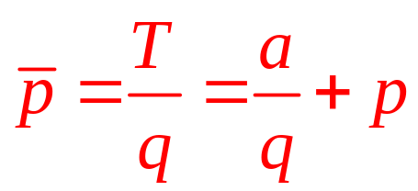
Two-Part Tariffs
Average price paid by any demander:
The two-part tariff
  Feasible if resale can be prevented
  Between those who pay a low price and those who pay a high price

Slide 47
Two-Part Tariffs
Profit maximization
  Set p = MC and then set a equal to the consumer surplus of the least eager buyer
    This might not be the most profitable approach
  In general, optimal pricing schedules will depend on a variety of contingencies

Slide 48
14.6 Two-Part Tariffs
Two different buyers with the demand functions: q₁ = 24 - p₁, and q₂ = 24 - 2p₂
  If MC = 6
Two-part tariff:
  Set p₁ = p₂ = MC = 6, so q₁ = 18 and q₂ = 12
  Demander 2 obtains consumer surplus of 36
    Maximum entry fee that can be charged without causing this buyer to leave the market
  The two-part tariff: T(q) = 36 + 6q
  Profits for the firm:
  π = T(q₁) + T(q₂) – AC(q₁ + q₂) = 72

Slide 49
14.6 Two-Part Tariffs
The optimal two-part tariff
  Total profits: π =2a + (p - MC)(q₁ + q₂)
  The entry fee, a, must equal the consumer surplus obtained by person 2
π =0.5 ·2 q₂(12-p) + (p - 6)(q₁ + q₂)
  Maximize profits: p = 9 and a = 9
  Optimal tariff is T(q) = 9 + 9q
    q₁ = 15 and q₂ = 6
    Monopolist’s profits = 81

Slide 50
Dynamic Price Discrimination and the Coase Conjecture
Intertemporal price discrimination
  Using time as a device to extract much of the surplus from each type of consumer
  May not help the monopolist
    High-value consumers can wait to buy at the lower prices
    Ronald Coase: a declining price path raises for a monopolist selling a durable good

Slide 51
Regulation of Monopoly
Highly regulated monopolies
  Natural monopolies: utility, communications, and transportation industries
Marginal cost pricing
  Will cause a natural monopoly to operate at a loss
    Natural monopolies exhibit declining average costs over a wide range of output

Slide 52
14.7 Price Regulation for a Decreasing Cost
Monopoly
Price
A
P_{A}
B
C
F
G
AC
P_{R}
MC
MR
E
D
Quantity
Q_{A}
Q_{R}
Because natural monopolies exhibit decreasing average costs, marginal costs decrease below average costs. Consequently, enforcing a policy of marginal cost pricing will entail operating at a loss. A price of P_{R}, for example, will achieve the goal of marginal cost pricing but will necessitate an operating loss of GFEP_{R}.

Slide 53
Regulation of Monopoly
Multiprice system (two-tier pricing)
  Charge some users a high price
  Maintain a low price for marginal users
Rate of return regulation
  Allow the monopoly to charge a price above marginal cost
  That is sufficient to earn a “fair” rate of return on investment

Slide 54
14.8 Two-Tier Pricing Schedule
Price
D
P₁
B
F
A
AC
P₂
MC
C
E
D
Q₁
Q₂
Quantity
per period
By charging a high price (P₁) to some users and a low piece (P₂) to others, it may be possible for a regulatory commission to (1) enforce marginal cost pricing and (2) create a situation where the profits from one class of users (P₁DBA) subsidize the losses of the other class (BFEC)

Slide 55
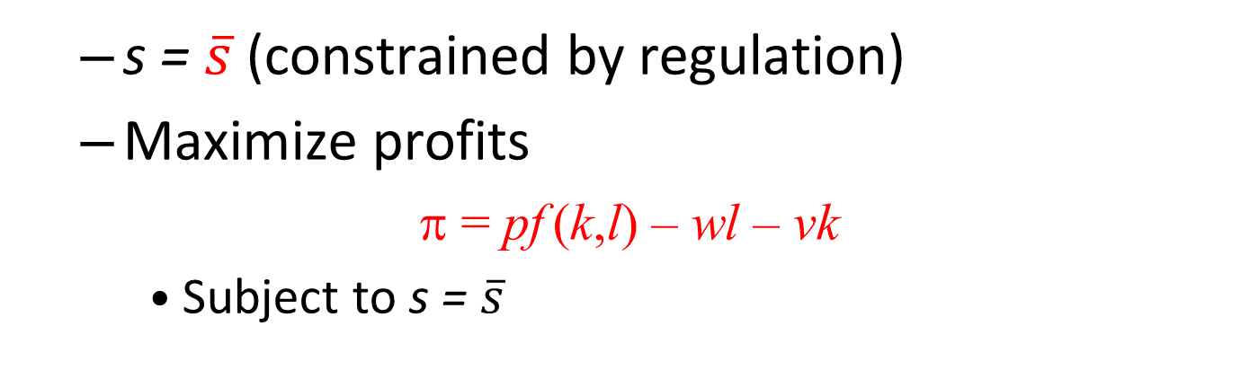
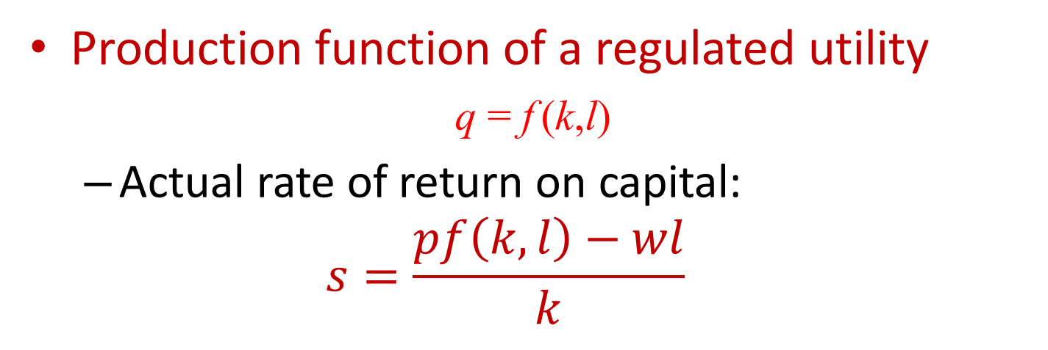
Regulation of Monopoly
Production function of a regulated utility
q = f (k,l)
  Actual rate of return on capital:
  $$s=\frac{pf\left(k,l\right)−wl}{k}$$
  s = $\overline{s}$ (constrained by regulation)
  Maximize profits
π = pf (k,l) – wl – vk
    Subject to s = $\overline{s}$

Slide 56
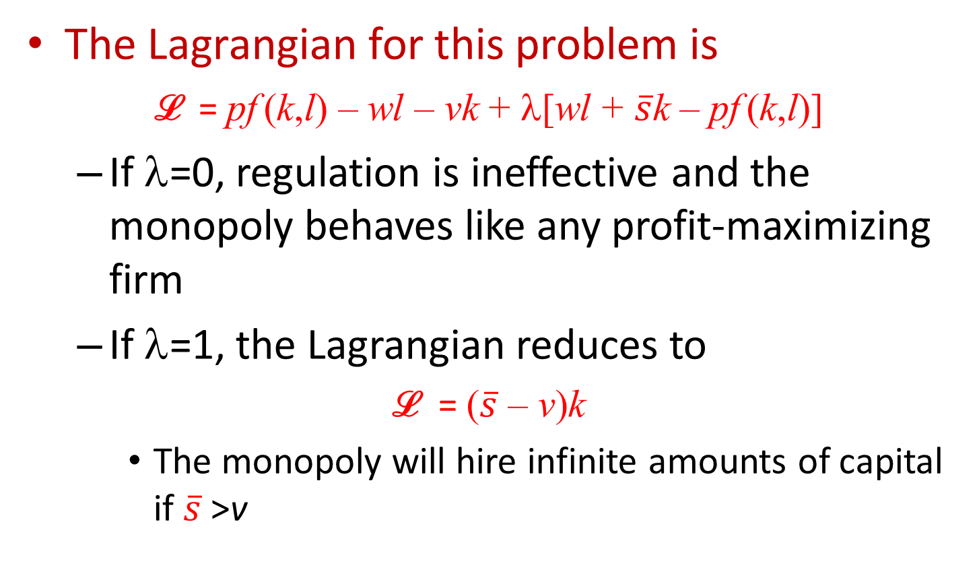
Regulation of Monopoly
The Lagrangian for this problem is
ℒ = pf (k,l) – wl – vk + λ[wl + $\overline{s}$k – pf (k,l)]
  If λ=0, regulation is ineffective and the monopoly behaves like any profit-maximizing firm
  If λ=1, the Lagrangian reduces to
ℒ = ($\overline{s}$ – v)k
    The monopoly will hire infinite amounts of capital if $\overline{s}$>v

Slide 57
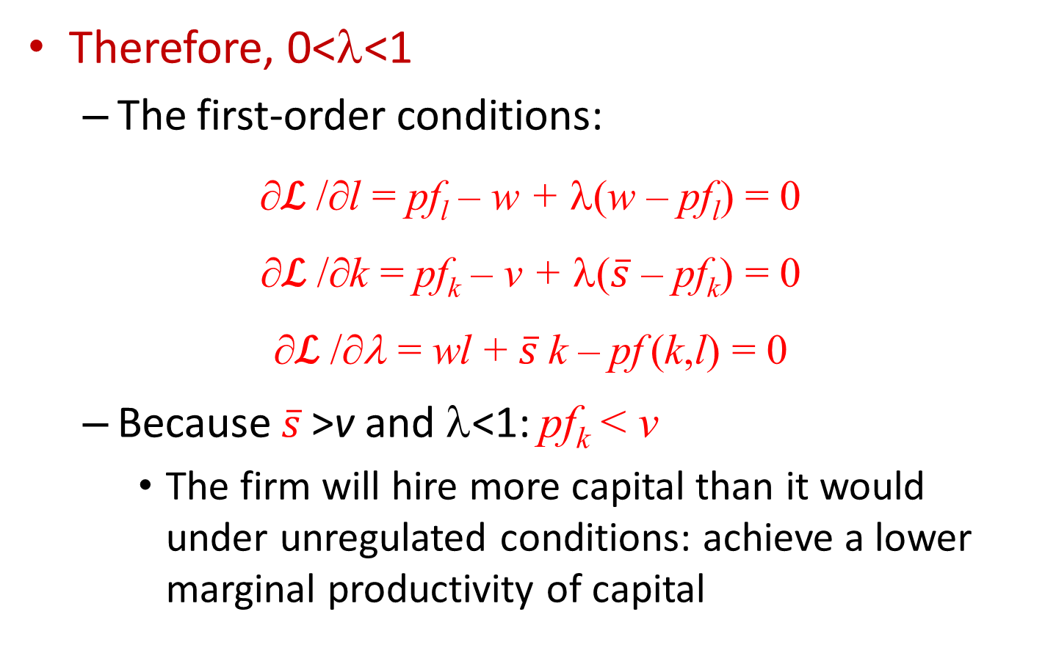
Regulation of Monopoly
Therefore, 0<λ<1
  The first-order conditions:
∂ℒ /∂l = pf_{l} – w + λ(w – pf_{l}) = 0
∂ℒ /∂k = pf_{k} – v + λ($\overline{s}$ – pf_{k}) = 0
∂ℒ /∂λ = wl + $\overline{s}$k – pf (k,l) = 0
  Because $\overline{s}$>v and λ<1: pf_{k} < v
    The firm will hire more capital than it would under unregulated conditions: achieve a lower marginal productivity of capital

Slide 58
Dynamic Views of Monopoly
Monopoly profits
  Beneficial role in the process of economic development
  Provide funds that can be invested in research and development
  Provides an incentive to keep one step ahead of potential competitors

Slide 59
Optimal linear two-part tariffs
Valuation function: v_{i}(q) = p_{i}(q)·q + s_{i}
  p_{i}(q) - the inverse demand function for individual i
  s_{i} - consumer surplus
  v_{i} - total value to individual i of undertaking transactions of amount q
    Includes total spending on the good plus the value of consumer surplus obtained

Slide 60
Optimal linear two-part tariffs
Assume
  There are only two demanders (or homogeneous groups of demanders)
  Person 1 has stronger preferences for this good than person 2: v₁(q) > v₂(q)
    For all values of q

Slide 61
Optimal linear two-part tariffs
The monopolist
  Constant marginal costs, c
  Chooses a tariff (revenue) schedule, T(q)
    Maximizes profits
  Profits: π = T(q₁) + T(q₂) – c(q₁ + q₂)
  Faces two constraints – to differentiate among consumers
    v₂(q₂) – T(q₂) ≥ 0
    v₁(q₁) – T(q₁) ≥ v₁(q₂) – T(q₂)

Slide 62
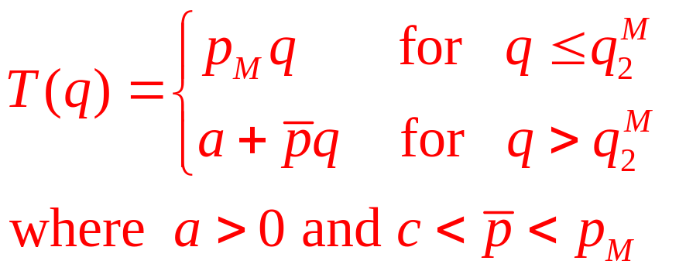
Pareto superiority
Monopolist’s profit maximizing price, p_{M}
  Person 2 consumes q₂^{M}
    Receives a net value from this consumption: v₂(q₂^{M}) – p_{M}q₂^{M}
  Increased profits with a tariff schedule

Slide 63
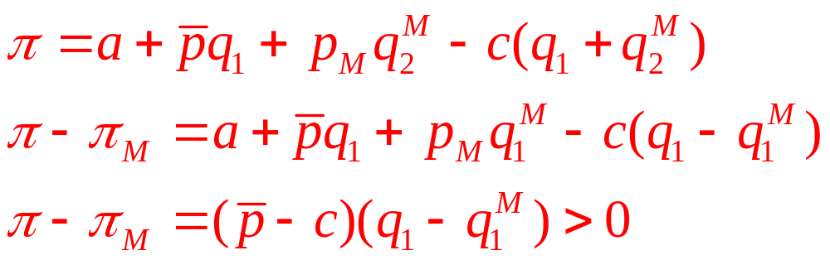
Pareto superiority
  Monopoly’s profits:

Slide 64
Tied sales
Tied sales
  A monopoly will market two goods together
    Situation poses a number of possibilities for discriminatory pricing schemes
Market segmentation
  Achieved through quality variation
  Significant transfer from consumer surplus to firms

